Slide 1
Credit Card Fraud Detection
By Yaswanth
MSc Data Science
University of Essex

Slide 2

Introduction
Billions of dollars of loss.
Imbalance dataset & Skewness in data.
Rule based systems to ML
Supervised & Unsupervised

Slide 3

Aim
Design model
Four different algorithms and Resampling techniques
Python

Slide 4
Methodology
Data Collection
Data Analysis & Pre-processing
Resampling
Model Building
Model Evaluation

Slide 5
Data Collection
Kaggle Competition (csv format)

Slide 6
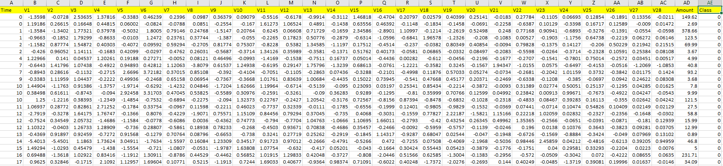
Data Description

Slide 7

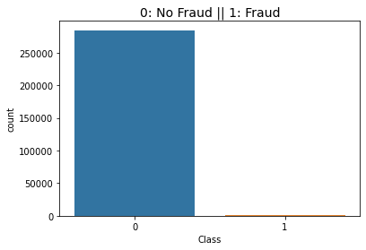
Data Analysis & Pre-processing
Null and duplicate values
Class Imbalance

Slide 8
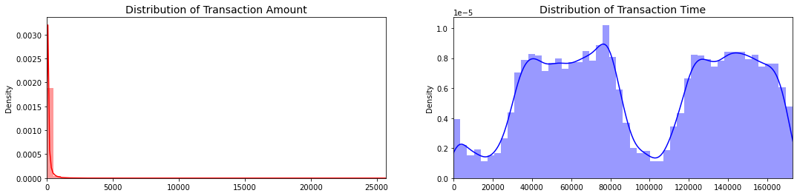

Distributions

Slide 9
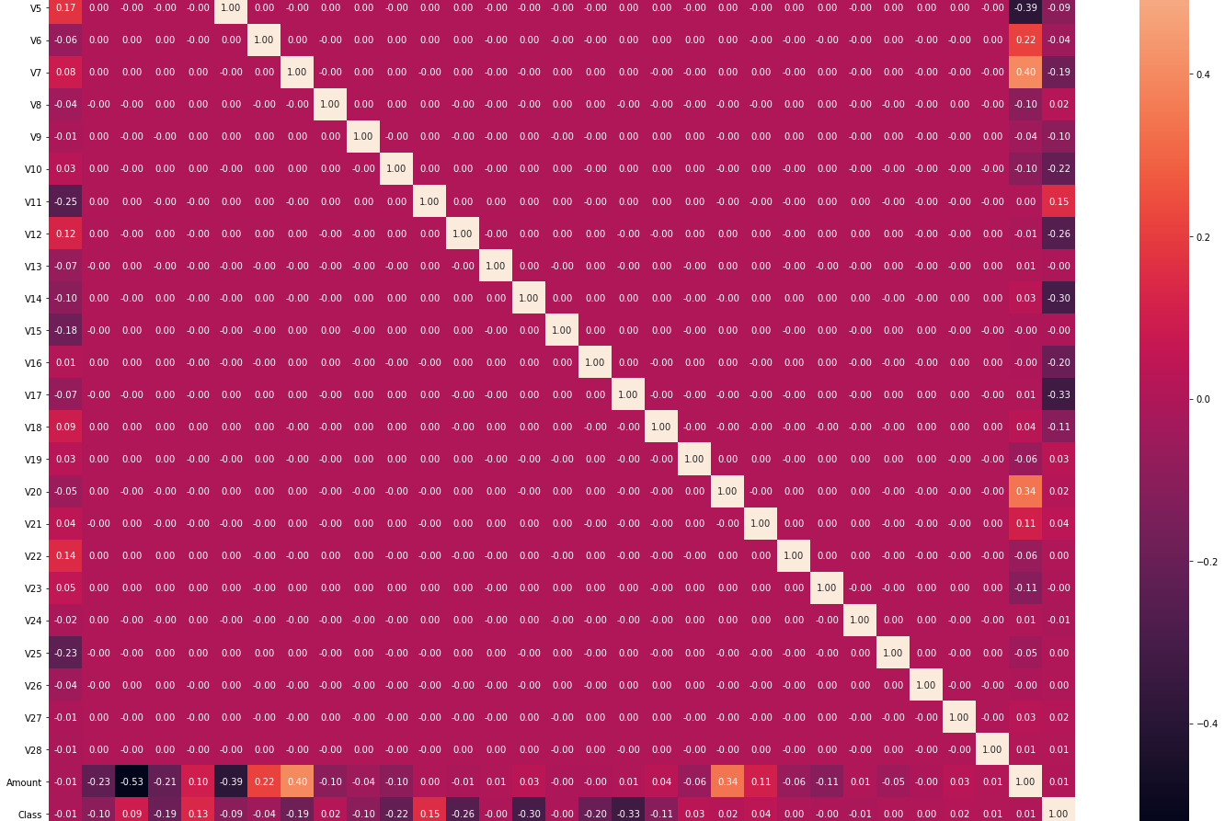
Correlation with actual data

Slide 10
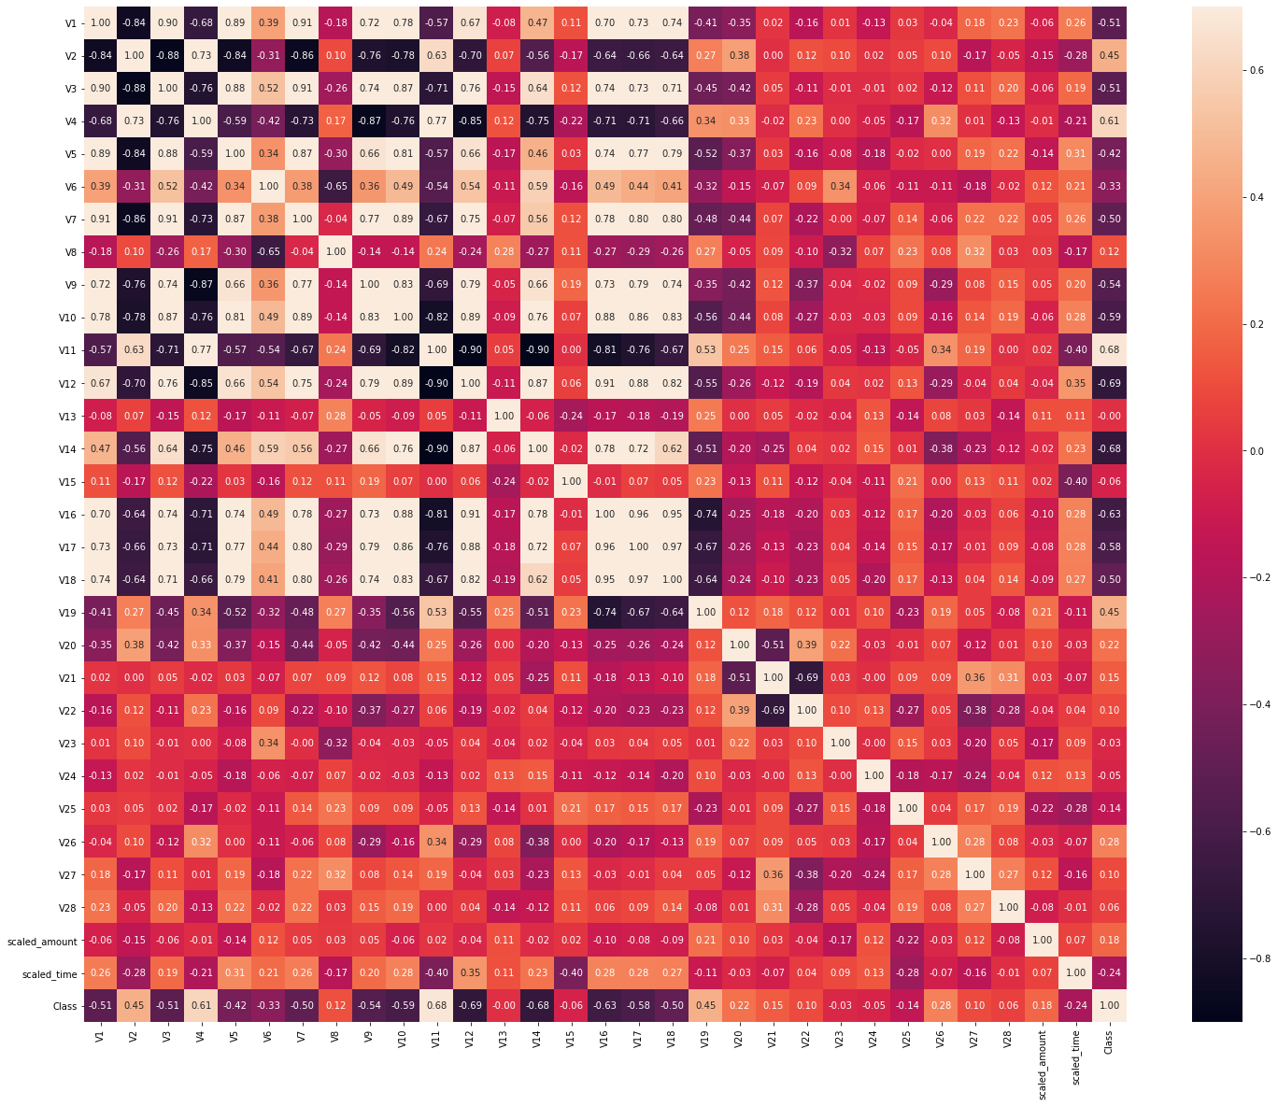
Under-sampled data correlation

Slide 11
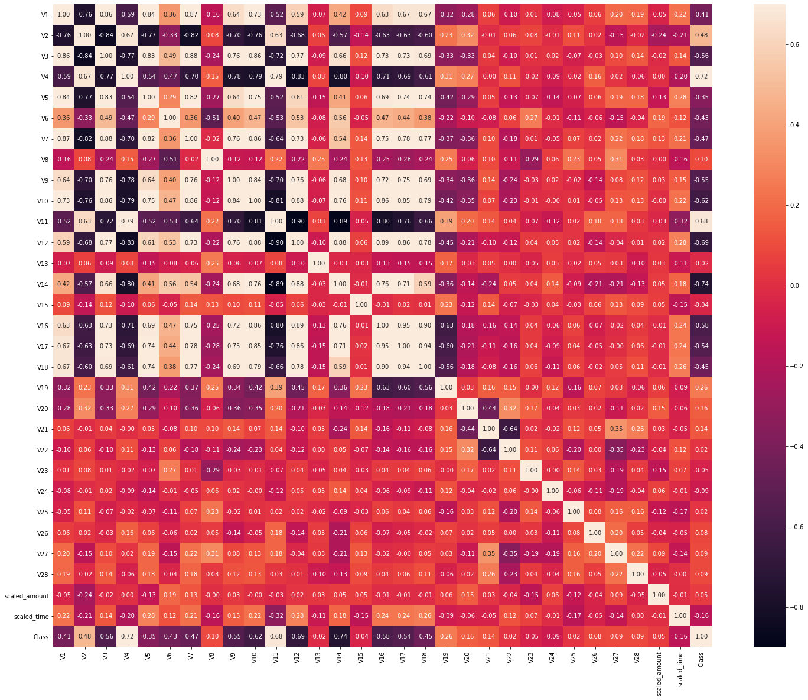
Over-sampled data correlation

Slide 12
Model Building
Splitting data
Hyper-parameter tuning
Random search Cross Validation

Slide 13
Model Evaluation
Accuracy
Precision
Recall
F1-score

Slide 14
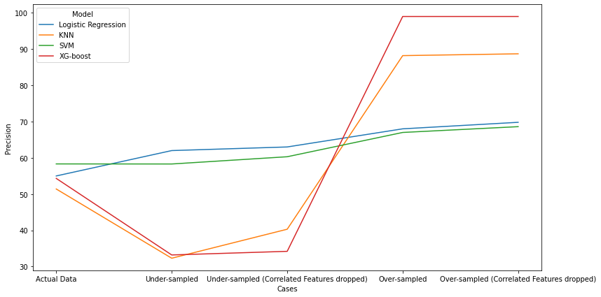
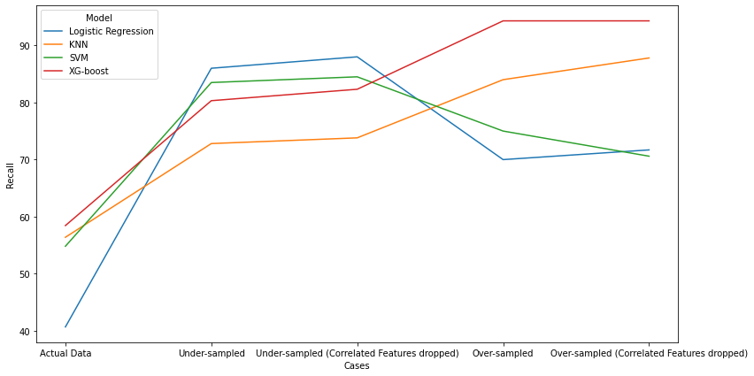
Results

Slide 15

Conclusion
Good Results with Over sampled data and XG boost

Slide 16
Further Work
Deep Neural Networks.
More data for better understanding.

Slide 17

Thank you

